Slide 1
100 Years of Empowering Women
Centennial Anniversary Celebration Strategy and Plan

Slide 2
Empowering Women
A central idea that allows for
honoring the past
while
focusing our actions on Zonta’s future

Slide 3
100 Years of Empowering Women
A theme for our centennial anniversary derived from our mission to empower women through service and advocacy

Slide 4
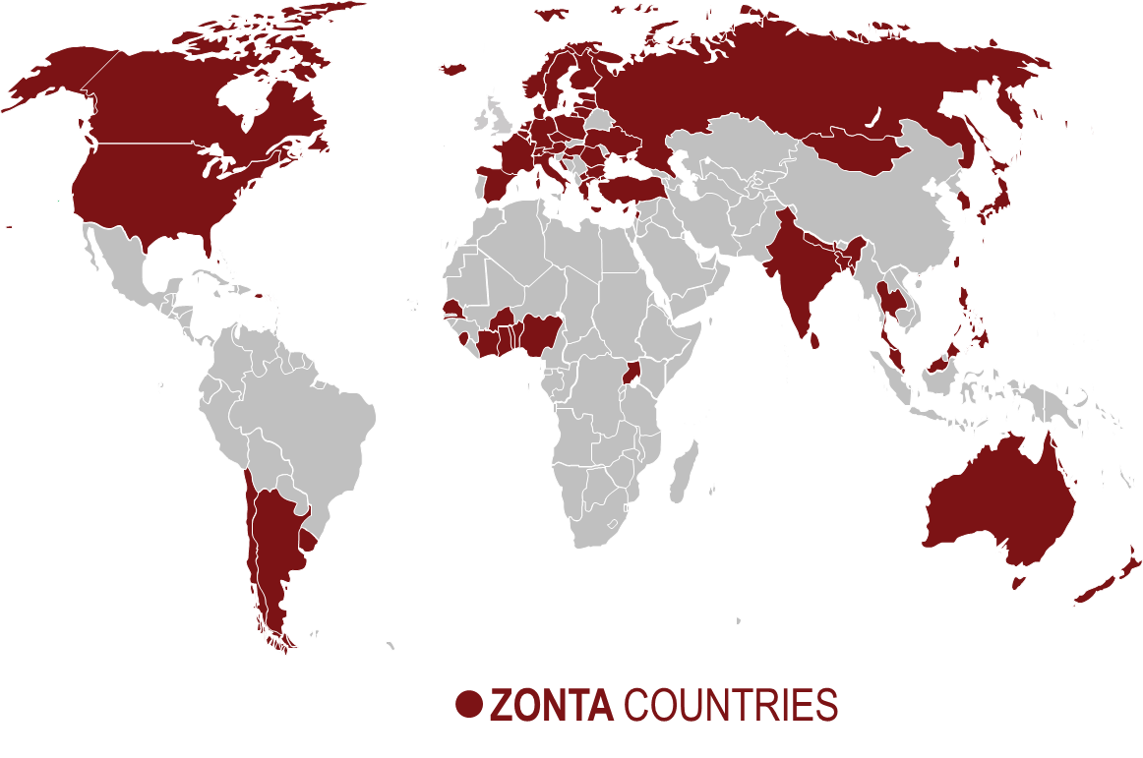
Honor and Empower
Our action motto to ensure visibility across the Zonta world

Slide 5
Honor and Empower: 3 Challenges
Membership Challenge
Centennial Membership
Awards
Club Service
Challenge
Centennial Local
Service Awards
International
Fundraising
Challenge
Centennial
Fundraising
Awards

Slide 6
Honor and Empower
100 special Centennial Awards will be presented throughout the world to high-profile people who are empowering women
More Centennial Awards can be presented by clubs to high-profile people in their communities.

Slide 7
2019 District Conferences
Featuring Centennial celebrations and invitations to alumnae of Zonta’s education programs

Slide 8
Common Action
8 November 2019

Slide 9
Portraits of Great Women
Portraits of great women who (have) shaped Zonta on the website, to share via social media, and as a print book

Slide 10
Central Umbrella
Centennial logo, guidelines, tools and support to enhance local celebrations will be provided by Zonta International

Slide 11
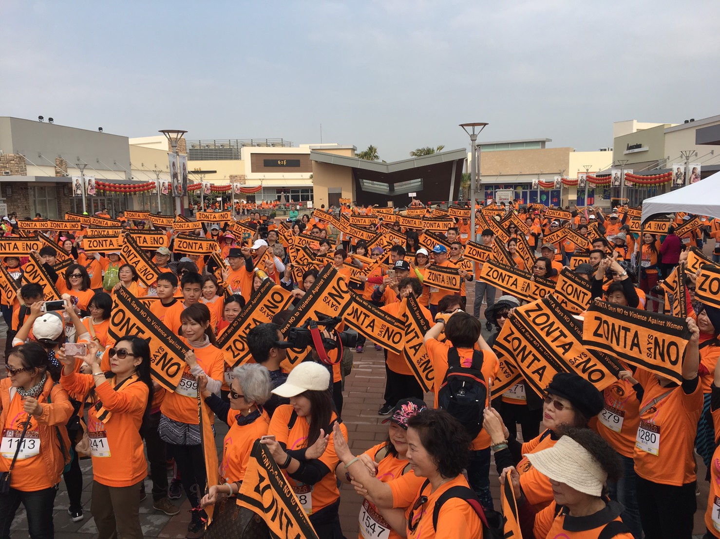
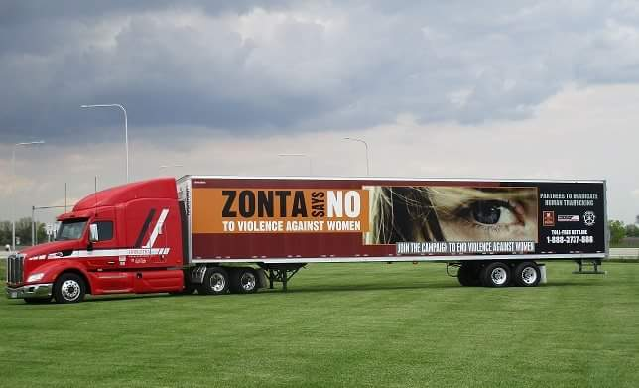
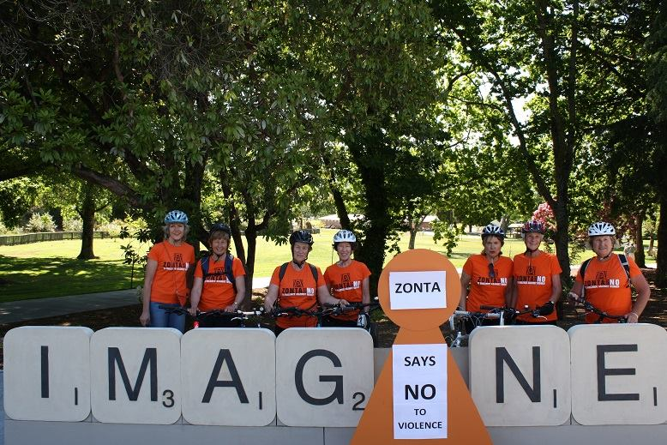
Maximum Autonomy
Allowing districts and clubs to define their own ways of empowerment
(model: Zonta Says NO to Violence Against Women)

Slide 12
Best Practices
Share best practices and results in a timely manner to enhance further visibility across Zonta districts

Slide 13
Scope: 2018-2020 Biennium
Not only one year (2019) but one entire biennium (2018-2020) of celebrations

Slide 14
Honor and Empower Action Milestones
Launch www.zonta100.org
2018 Convention kick-off celebration
100 quotes posted on www.zonta.org in 2019
100 stories on heroines posted on www.zonta100.org in 2019
Centennial Anniversary Endowment Campaign
District Conferences with Alumnae events
Common action on 8 November 2019
Special event at CSW 2020
2020 Convention

Slide 15
Timeline
 | What?
end of March 2017 | Strategy and Plans to the Governors
 | Job Description for District Centennial Coordinator distributed
end of June 2017 | Planning tools continually posted on the website
 | Centennial Coordinators’ Call
September 2017 | Gov. Call call prior to District Conferences, Centennial logo and first templates available
Sept./Oct. 2017 | CAEC presentations at District Conferences
end of Dec. 2017 | Centennial micro site up, constantly filled up
Convention 2018 | Kick-off Centennial Biennium, CAEC booth, from now on updates on the status of donations to the Endowment fund posted on the Centennial microsite
Nov./Dec. 2018 | Campaign: Zonta Says No to Violence Against Women
January 2019 | First portrait of a Zonta heroine posted, one per week will follow
August 2019 | Pre-ordering of Centennial book starts
Sept./Oct. 2019 | Districts will include celebration element in their program, as well as invitations of Alumnae of ZI’s educational programs
Nov. 8, 2019 | Common action for all Zonta clubs
November 2019 | Centennial book is published
 | Centennial issue of ZONTIAN with Call to Conference
Nov./Dec. 2019 | Zonta Says No to Violence Against Women
March 2020 | Special Anniversary event at CSW
July 2020 | Chicago Centennial Convention

Slide 16
Outline: Job Description Centennial Coordinator
Enthuse
Stay current on the latest Centennial information and resources through www.zonta100.org and newsletters
Give these information to Area Directors and clubs
Provide Centennial education sessions for clubs and assist Area Directors
Communicate
Encourage and support clubs in organizing Centennial activities
Communicate Centennial goals and objectives to clubs
Inform Area Directors and clubs of Centennial news and upcoming deadlines
Organize an exchange of best practice and ideas
Maintain awareness of club Centennial activities in the district
Report
Ask for Centennial reports from each Club and process them

